Slide 1
Position Sensitive detector - Principle and working
MscEEE - Engineering Project 1
Prepared by Georgey Baby Valavathu

Slide 2
Agenda
Why PSD?
Working principle
PSD types
Characterstics of a PSD

Slide 3
Why choose PSD over a regular photo diode?

Slide 4
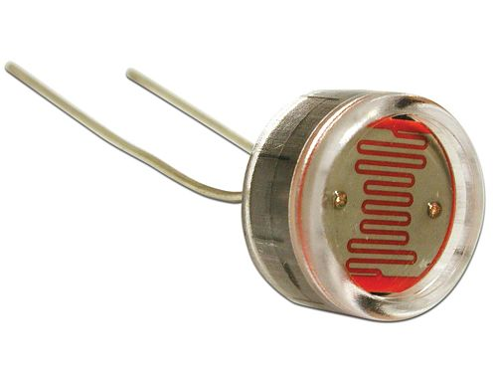
A: Houston, do we have light?
B: Yes we have.
A: Over and out
Figure 1: A picture of photo diode [1]

Slide 5
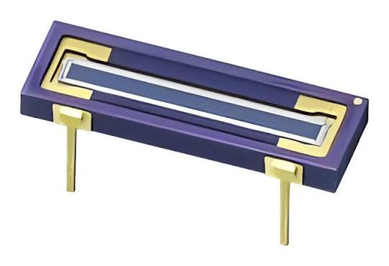
A: Houston, do we have light?
B: Yes we have
A: Coordinates?
B: 23,0345 and -10,9030
Figure 2: A picture of Position Sensitive Detector [2]

Slide 6
Working Principle of a Position Sensitive detector

Slide 7
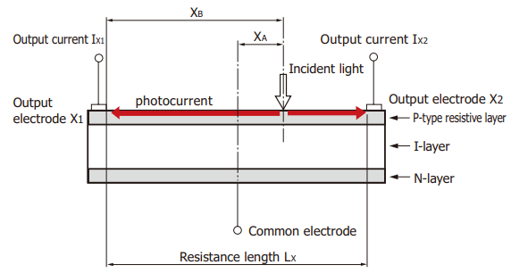
Figure 3: Cross sectional schematic of a Position Sensitive Detector [3]

Slide 8
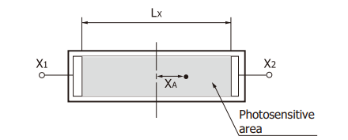
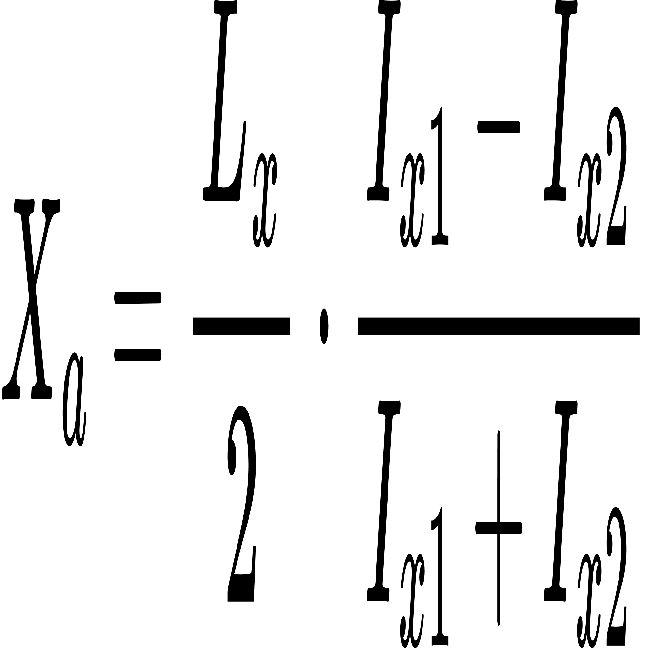
Figure 4: Photo sensitive area (one-dimensional) [3]

Slide 9
PSD types - lateral and segmented

Slide 10
Lateral effect PSDs
Uniform resistive layer
Calculation of position using ratio of current across electrodes
1 dimensional and 2 dimensional

Slide 11
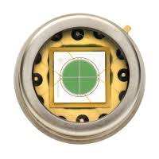
Segmented/Quadrant PSDs
Sensing area is divided into 4 quadrants.
Each area is independent and generates a current.
Figure 5: Picture of a quadrant PSD [4]

Slide 12
PSD Characterstics

Slide 13
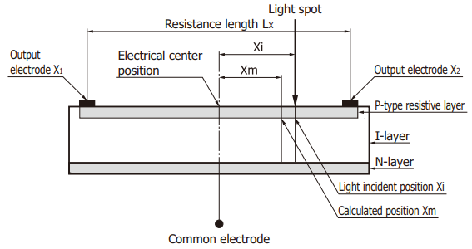
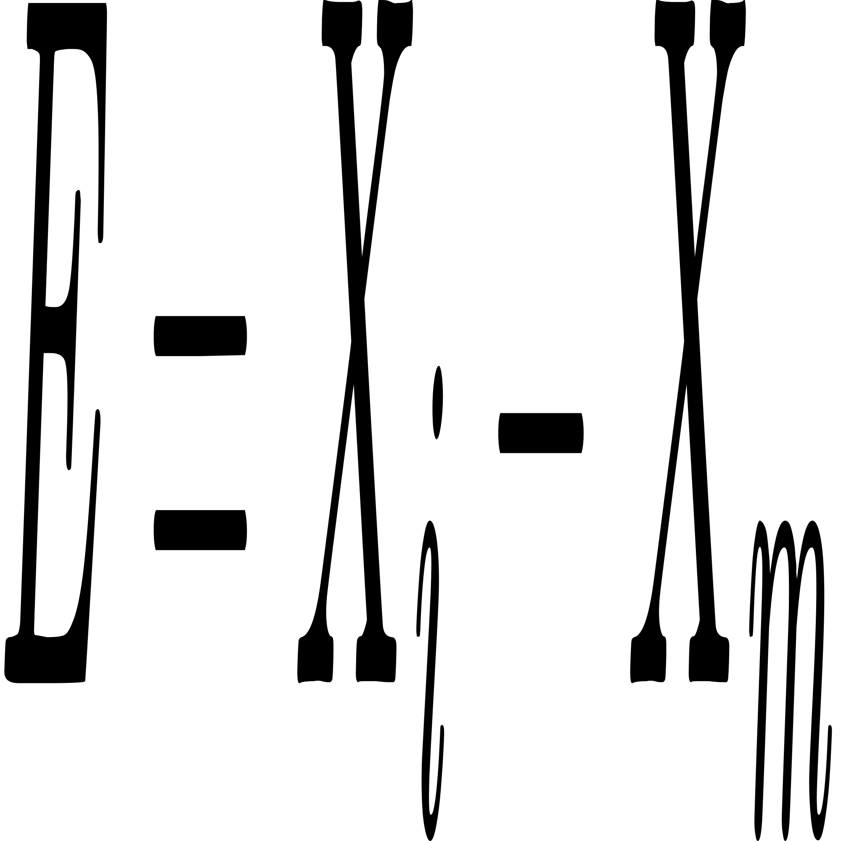
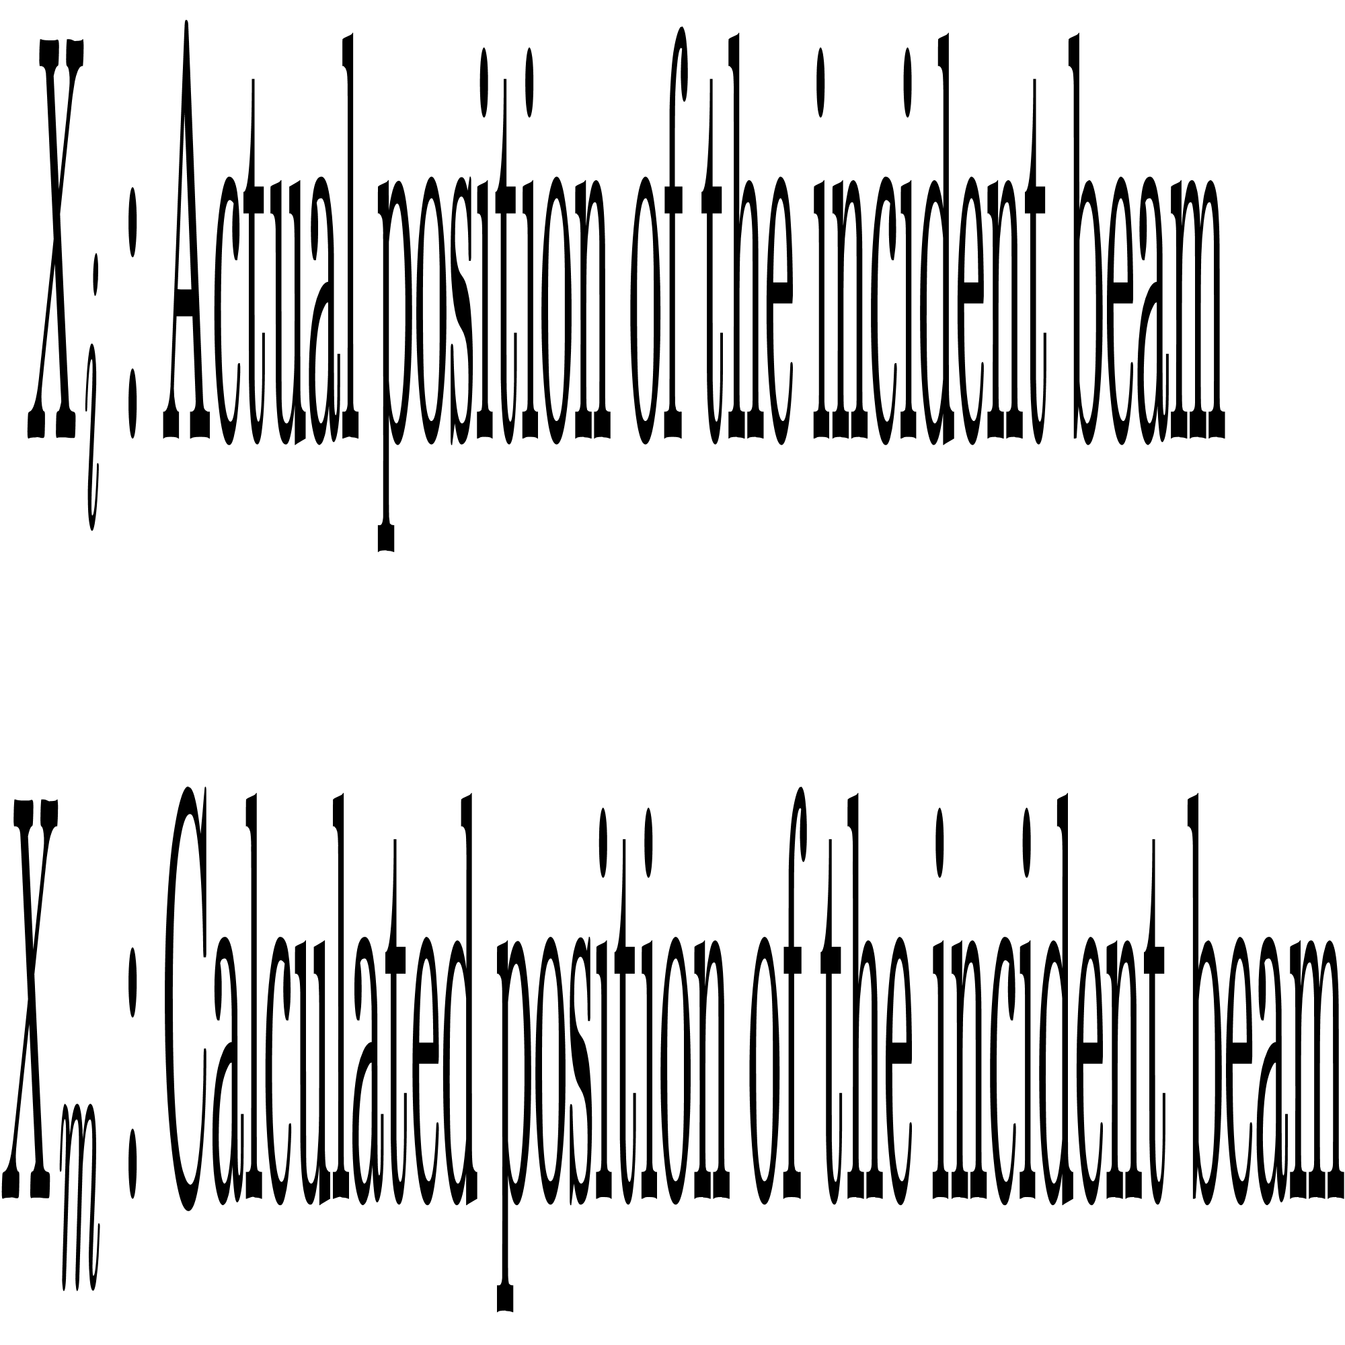
Position Detection Error
Figure 6: Cross sectional schematic of a PSD [3]

Slide 14
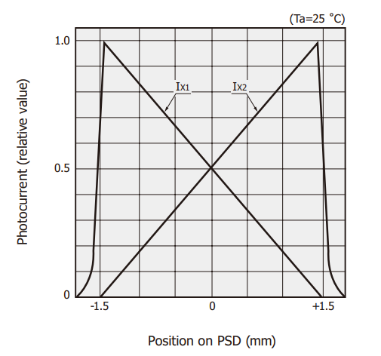
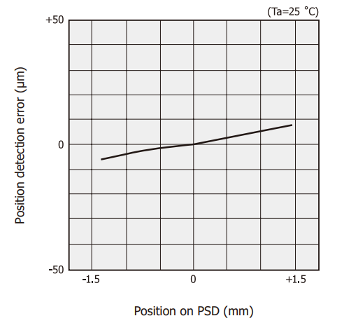
Figure 7: (A) Photocurrent measurement example of S4583-04
(B) Position detector error example of S4583-04 [3]
Notes:
it expects the resistivity of that layer to be perfectly uniform across the entire surface. In practice, tiny variations in the semiconductor's material, thickness, or edge contacts cause slight deviations from perfect linearity.

Slide 15
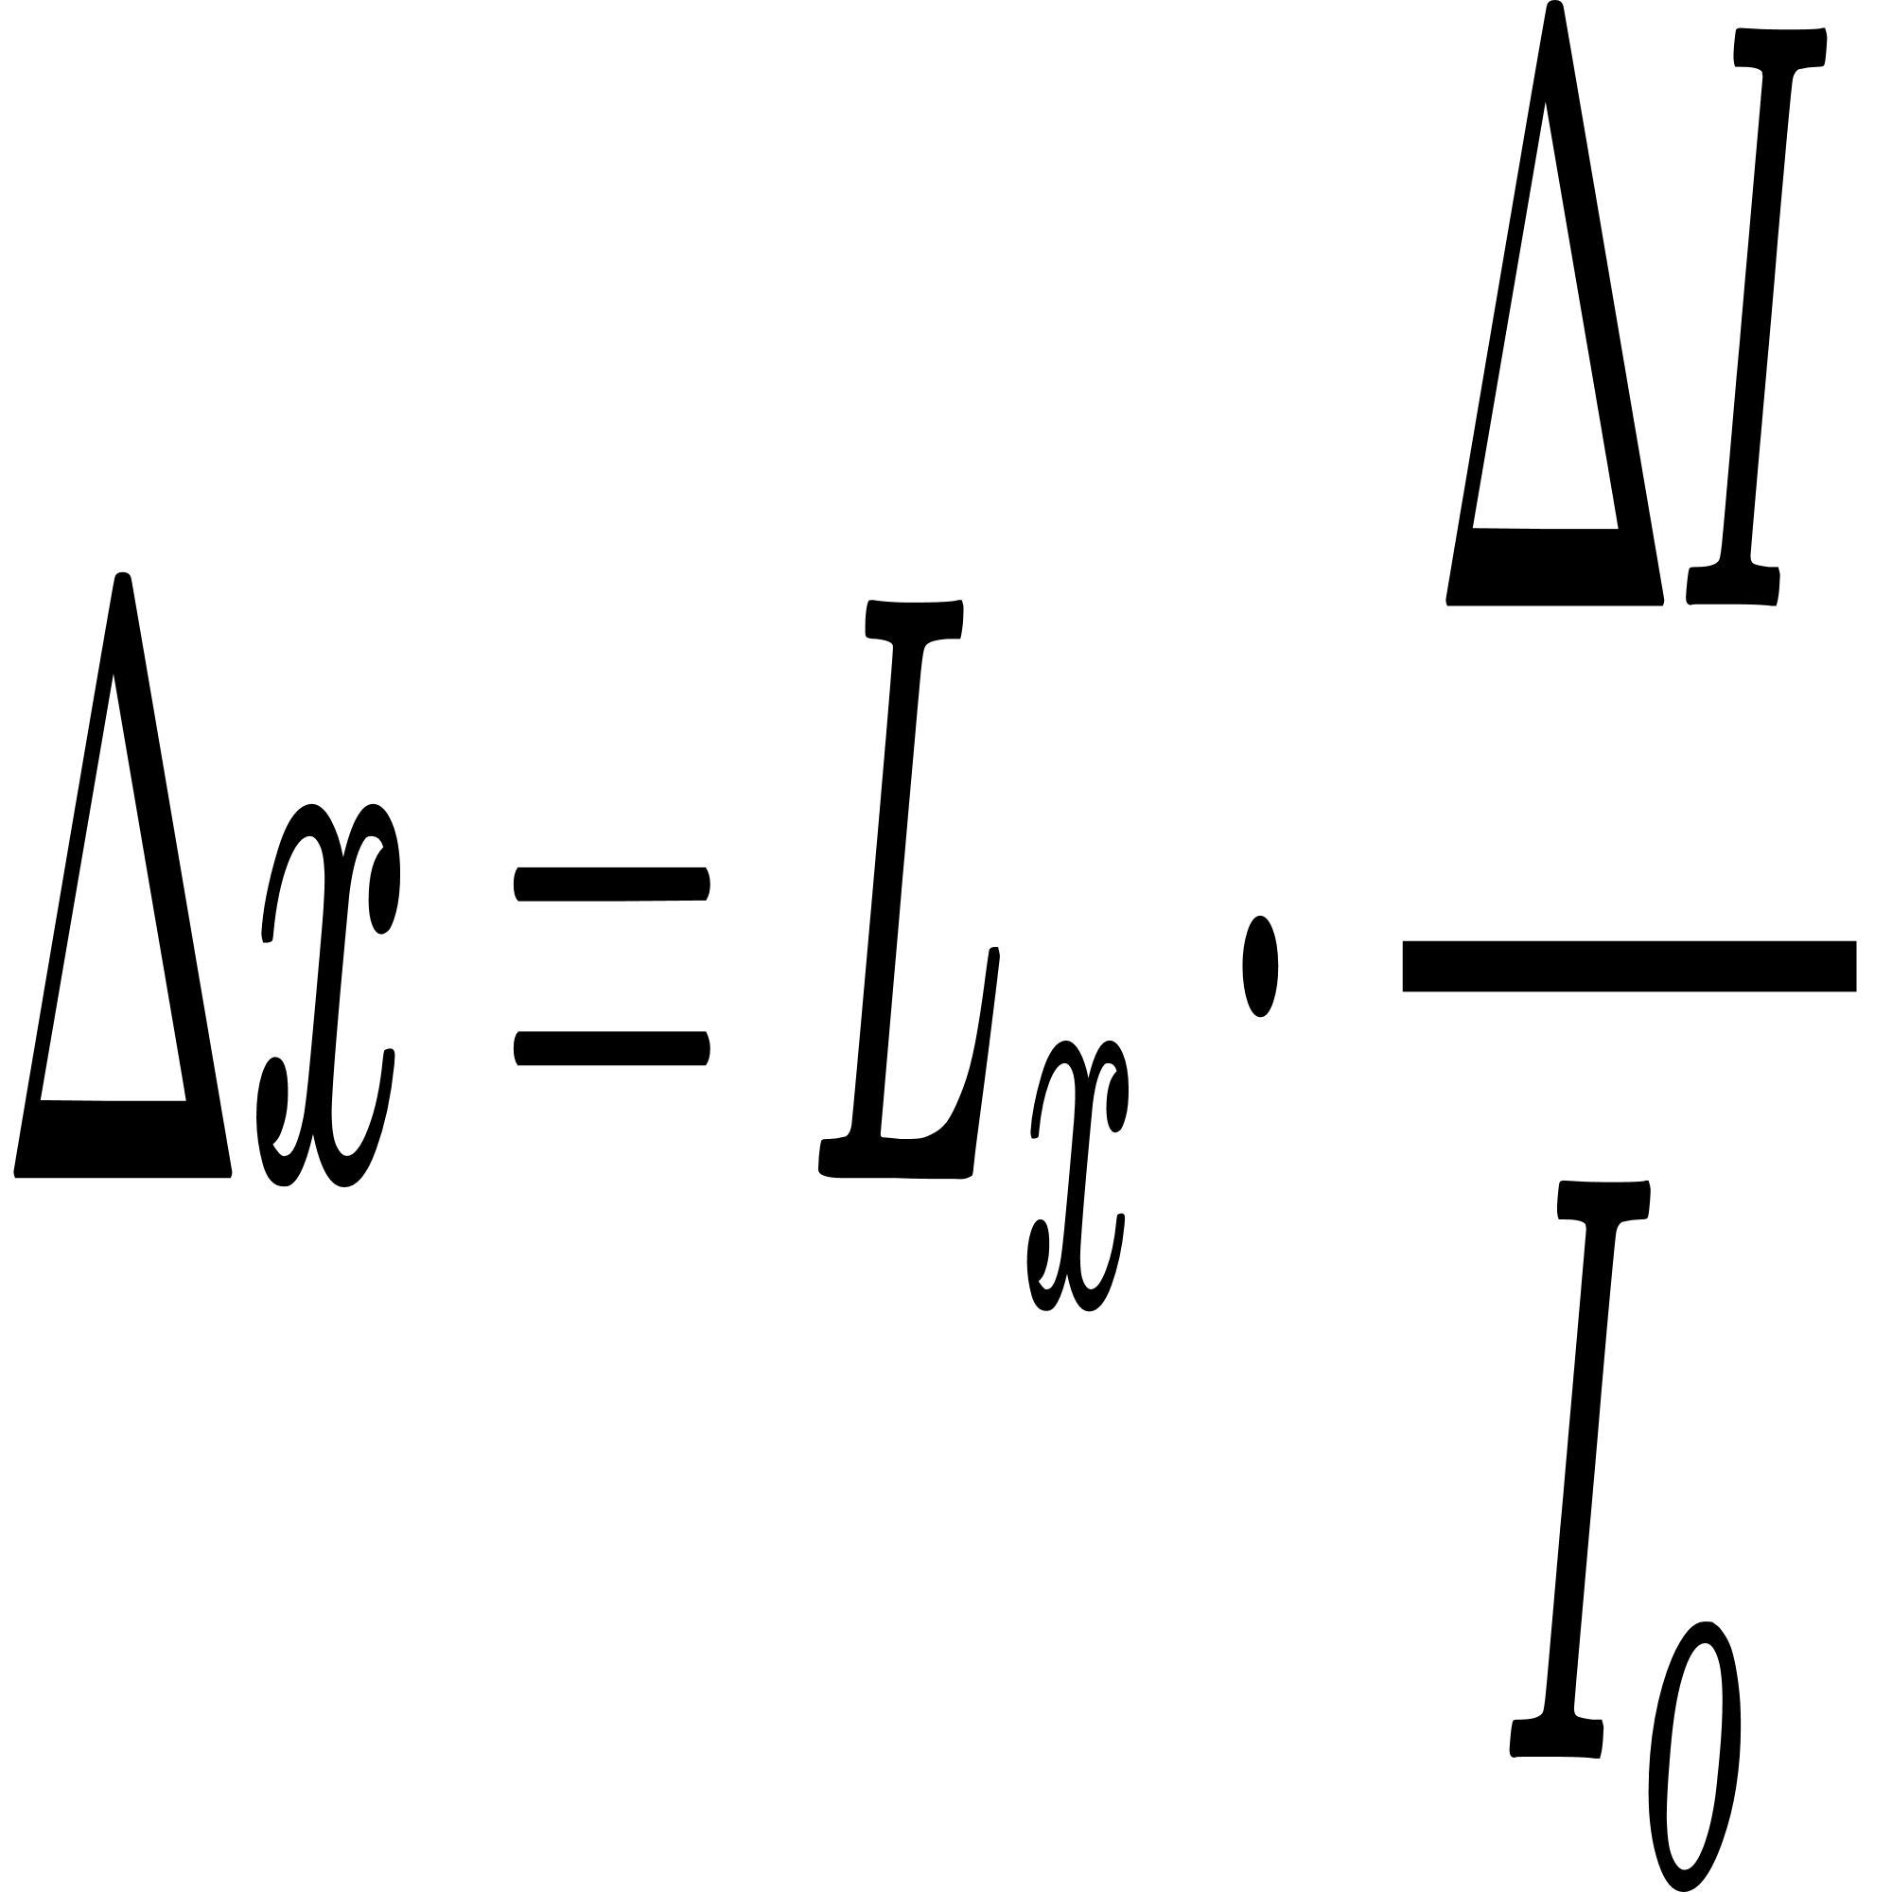
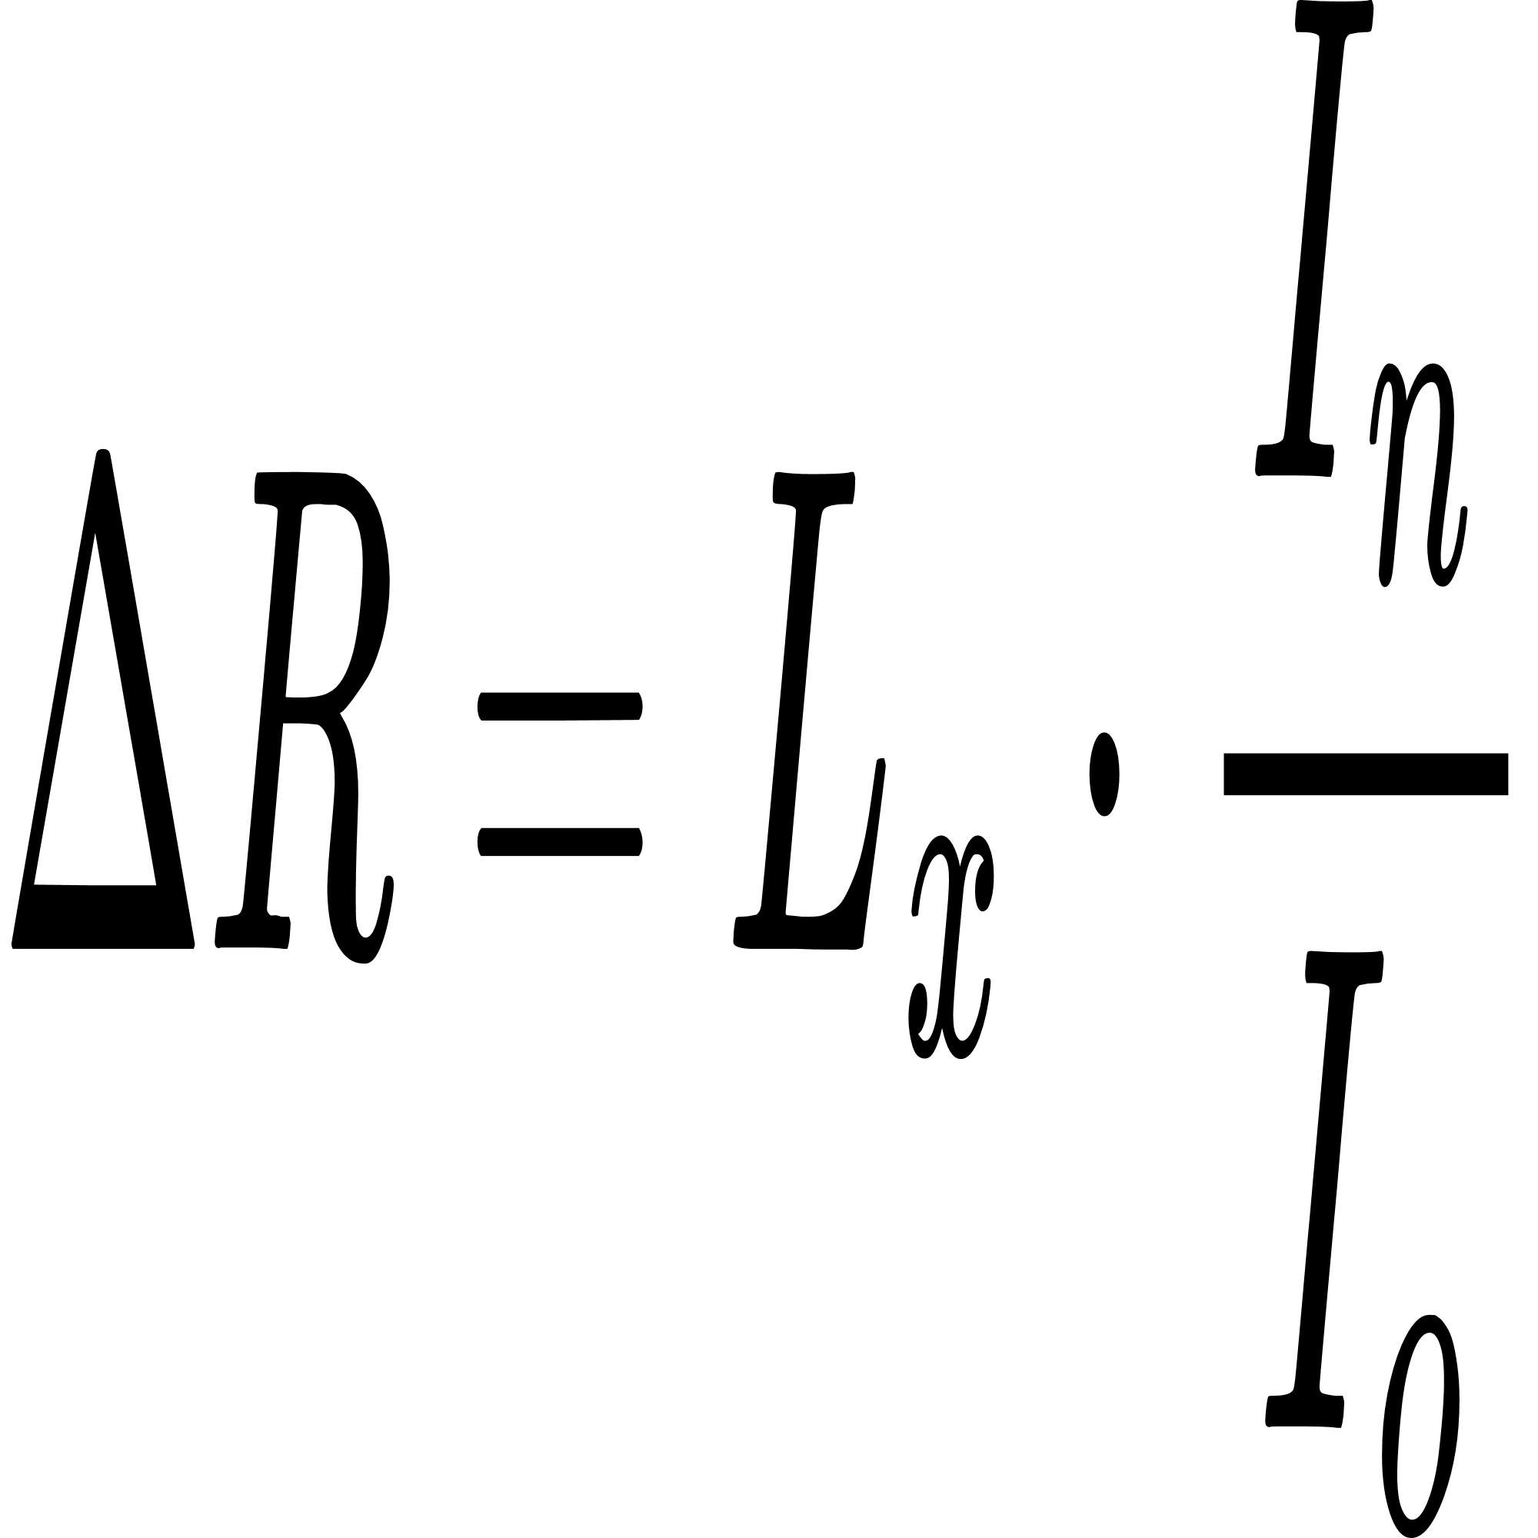
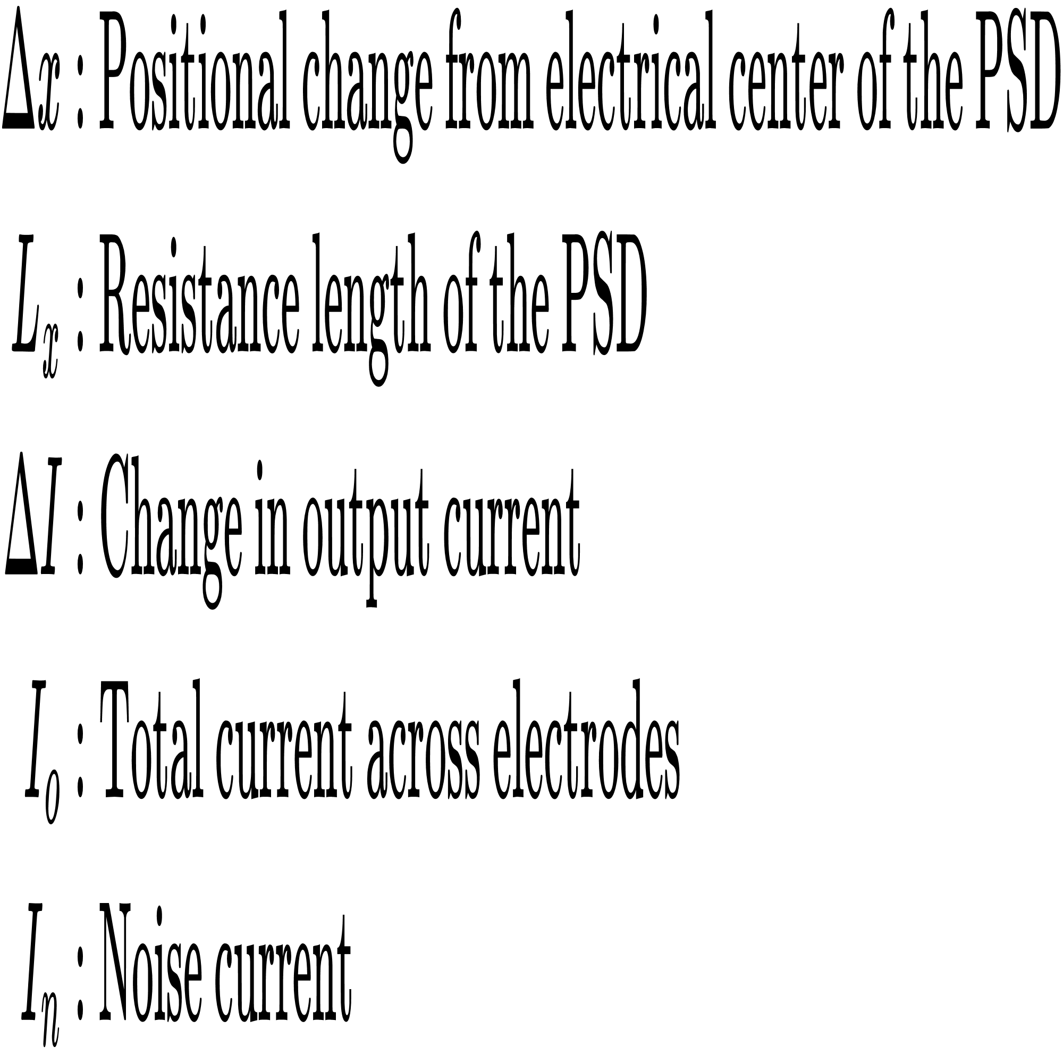
Position Resolution
when positional change is infinitely small, the noise component determines the Position resolution.

Slide 16
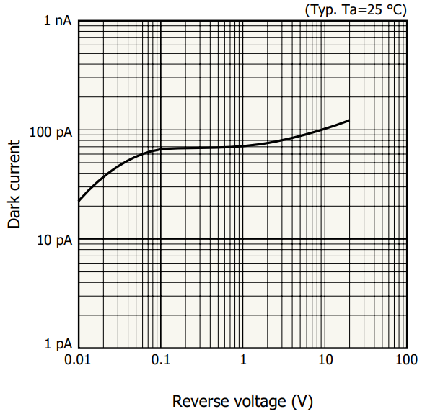
Dark current
Figure 8: Dark current vs Reverse voltage [5]
Notes:
Even when the room is pitch black and there is absolutely zero light hitting the sensor, a tiny amount of current still flows through the diode when a reverse voltage is applied. This is called dark current and is caused by random thermal generation of charges inside the silicon.
The flat curve tells you that you can safely apply a reverse bias of $1\text{ V}$ to $10\text{ V}$ to achieve the high bandwidth needed for tracking the cantilever's fast resonant frequency without suffering from a significant penalty in dark current noise.

Slide 17
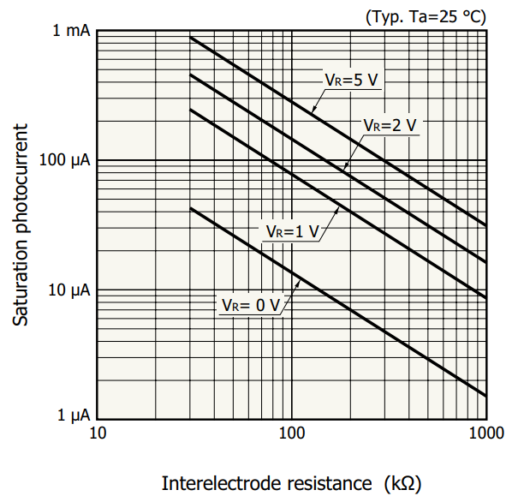
Saturation photocurrent vs Interelectrode resistance
Top layer of PSD acts as a uniform resistance.
Interelectrode resistance is the end to end resistance between electrodes.
If light is too intense, diode is unable to generate more current -> saturation.
Figure 9: Saturation photocurrent vs Interelectrode resistance [5]
Notes:
The PSD becomes highly non-linear. In a continuous PSD, the resistive layer acts as a current divider. However, when the laser spot is too bright, the massive localized current flowing through this resistive layer creates a local lateral voltage drop ($\Delta V = I \cdot R$).If this local voltage exceeds $\approx 0.6\text{ V}$, it locally forward-biases the p-n junction. This collapses the depletion barrier directly under the laser spot, allowing charges to leak straight through the junction into the substrate rather than traveling to the electrodes. This is why high interelectrode resistance forces the sensor to saturate at much lower light levels.
The position reading will distort, drift, or freeze.
Your cantilever measurement will completely fail because the high-frequency oscillation signal will be "clipped" (distorted), masking the true resonant peak.

Slide 18
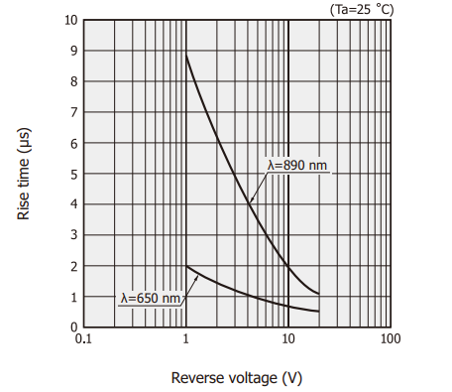

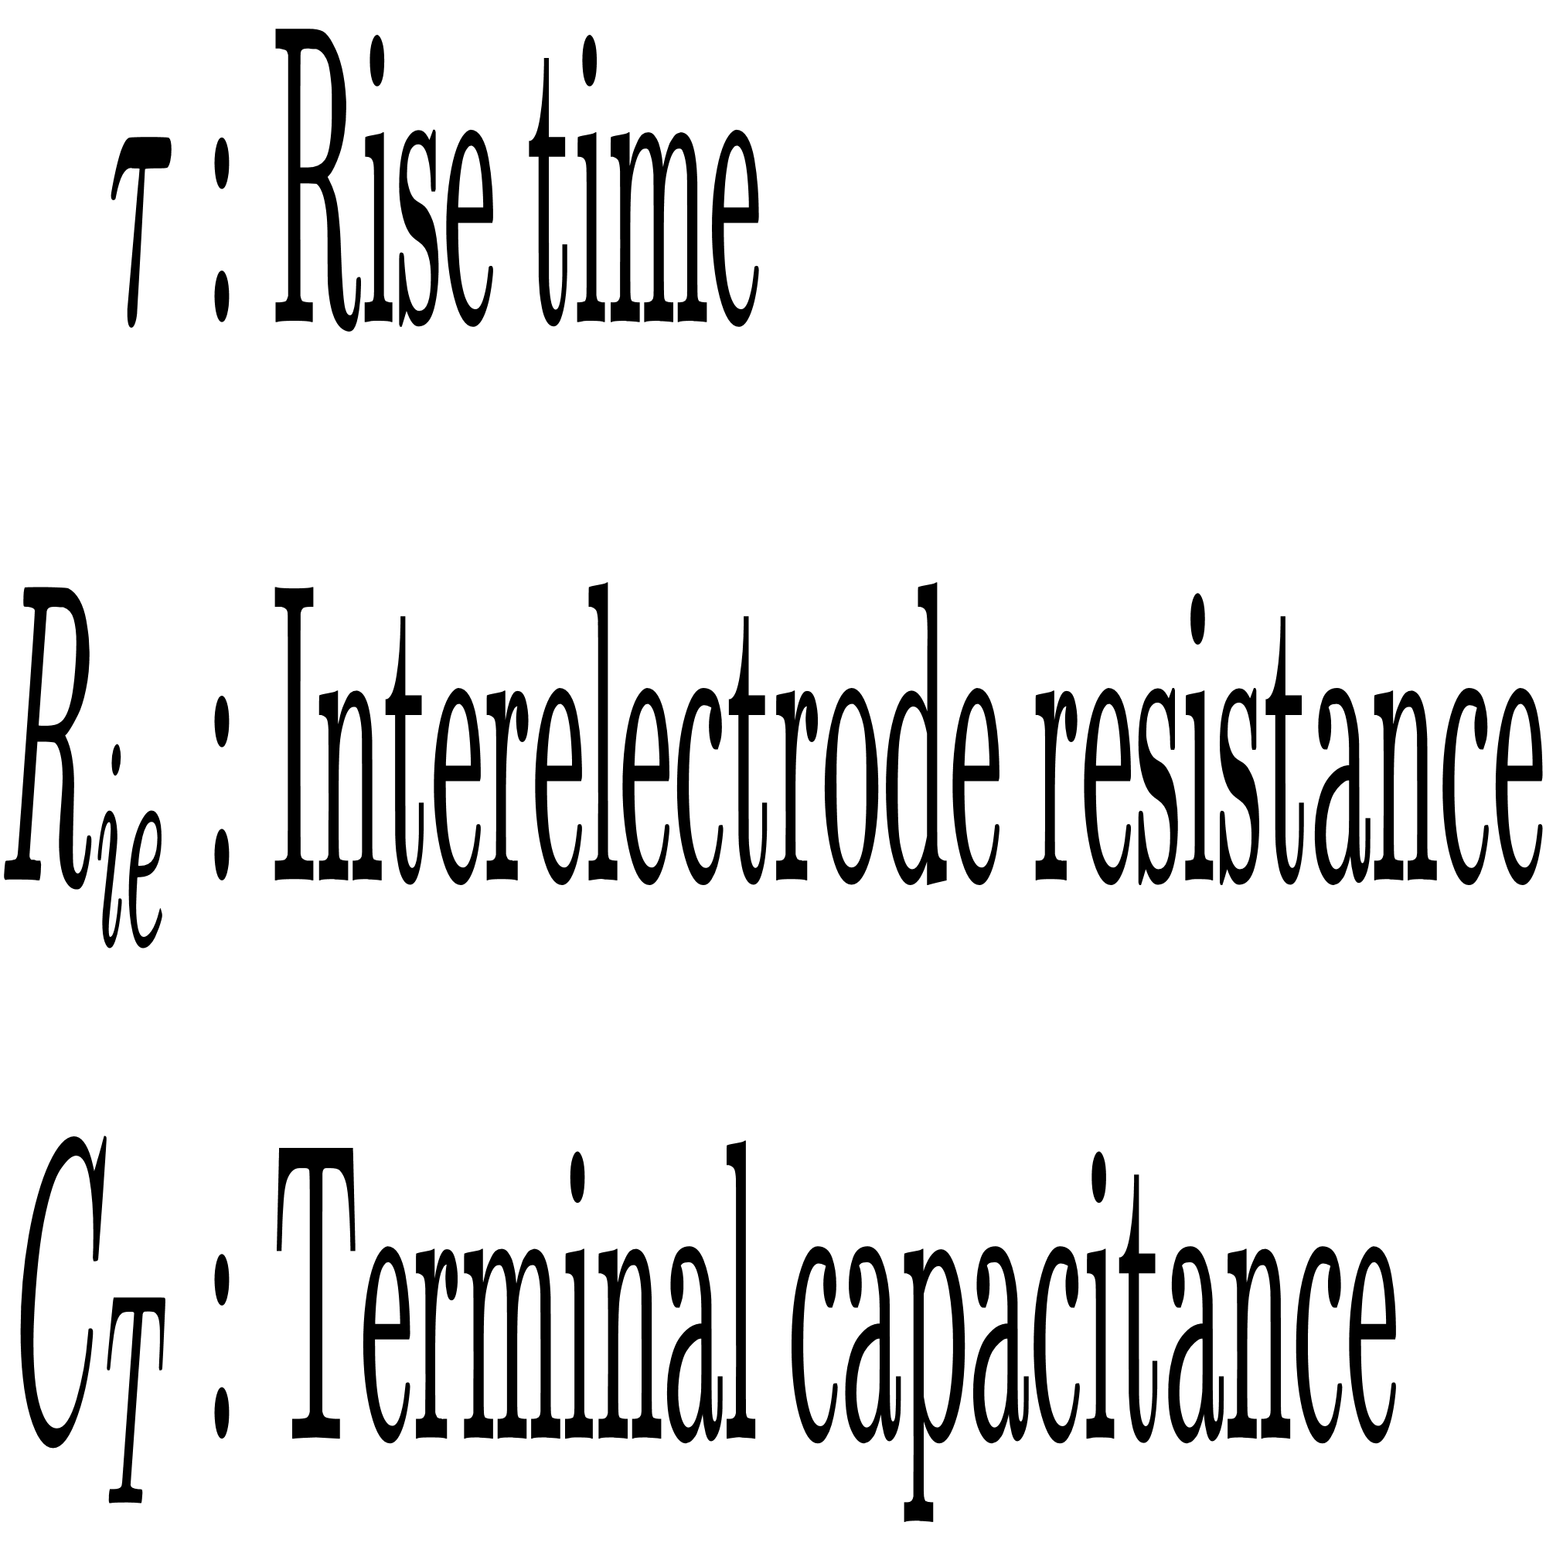
Rise time
Figure 10: Rise time vs Reverse voltage characterstics [3]

Slide 19
References
[1] “Read photo-diode / resistor as a digital value - Other Hardware / General Electronics,” Arduino Forum. Accessed: Jul. 14, 2026. [Online]. Available: https://forum.arduino.cc/t/read-photo-diode-resistor-as-a-digital-value/495950
[2] “S3932 HAMAMATSU, Positionsempfindlicher Detektor, eine Dimension, 1 x 12mm,” Farnell Deutschland. Accessed: Jul. 14, 2026. [Online]. Available: https://de.farnell.com/hamamatsu/s3932/1d-psd-detektor-1-x-12mm-920nm/dp/4258109
[3] “Technical note / PSD (position sensitive detectors),” Hamamatsu p. 10, Apr. 2026 [Online]. Available: https://www.hamamatsu.com/content/dam/hamamatsu-photonics/sites/documents/99_SALES_LIBRARY/ssd/psd_kpsd9001e.pdf
[4] “Quadrant APDs (QA) | First Sensor.” Accessed: Jul. 14, 2026. [Online]. Available: https://www.first-sensor.com/en/produkte/optische-sensoren/detektoren/quadranten-apds-qa/
[5] “One-dimensional PSD Plastic package,” p. 5, Oct. 2020. [Online]. Available: https://www.hamamatsu.com/content/dam/hamamatsu-photonics/sites/documents/99_SALES_LIBRARY/ssd/s4583-04_etc_kpsd1009e.pdf

Slide 20
Thankyou!
Prepared by Georgey Baby Valavathu

